Slide 1
GCN 실습
(Graph Convolution Network)
https://www.youtube.com/watch?v=qMZPMw27VB8&feature=youtu.be

Slide 2
GCN Preview
Advanced Techniques of GCN
GCN 코드

Slide 3
GCN Preview
Graph
 | 1 | 2 | 3 | 4
1 | 1 | 1 | 1 | 1
2 | 1 | 1 | 0 | 0
3 | 1 | 0 | 1 | 0
4 | 1 | 0 | 0 | 1
Adjacency Matrix
2
3
 | 1 | 2 | … | 10
1 | 1 | 1 | … | 0
2 | 1 | 1 | … | 1
3 | 0 | 0 | … | 1
4 | 1 | 0 | … | 1
1
4
Node Feature Matrix

Slide 4
GCN Preview
GCN Structure

Slide 5
GCN Preview
Graph Convolution Layer
H1^{(l+1)} = σ(H2^{(l)}W^{(l) +} H3^{(l)}W^{(l) +} H4^{(l)}W^{(l)})
2
3
1
H^{(l+1)} = σ(AH^{(l)}W^{(l)})
4

Slide 6
GCN Preview
H^{(l+1)} = σ(AH^{(l)}W^{(l)})
64
10
4
 |  |  | …
 |  |  | …
 |  |  | …
 |  |  | …
 |  |  | …
1 | 1 | … | 0
1 | 1 | … | 1
0 | 0 | … | 1
1 | 0 | … | 1
1 | 1 | 1 | 1
0 | 1 | 0 | 0
0 | 0 | 1 | 0
0 | 0 | 0 | 1
4
X
10
X
4
Node feature matrix
Adjacency matrix
H
Weight matrix
A
W
64
 |  |  | …
 |  |  | …
 |  |  | …
 |  |  | …
=>
4

Slide 7
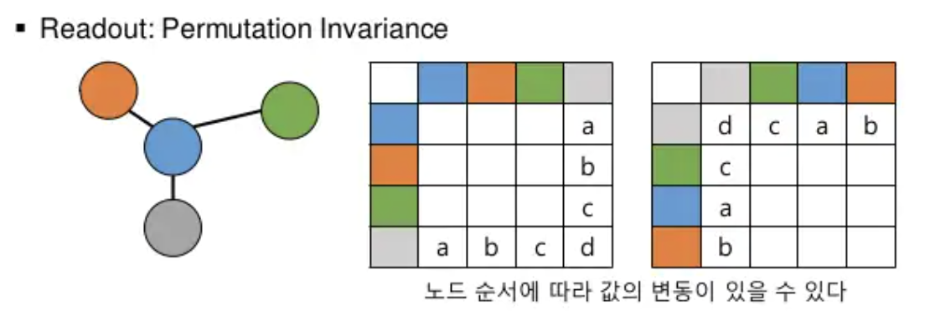
GCN Preview
Readout

Slide 8
Advance Techniques of GCN
Skip Connection

Slide 9
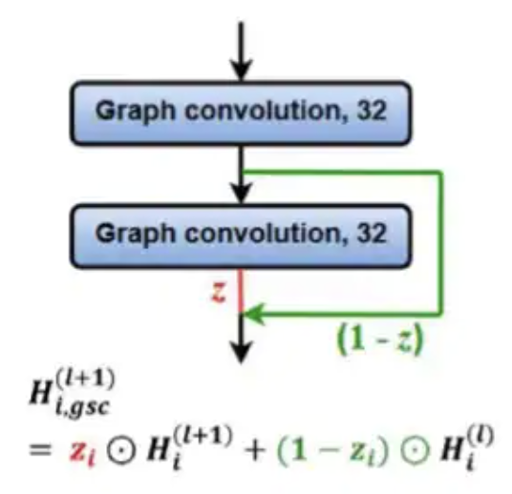
Advance Techniques of GCN
Gated Skip Connection

